Slide 1
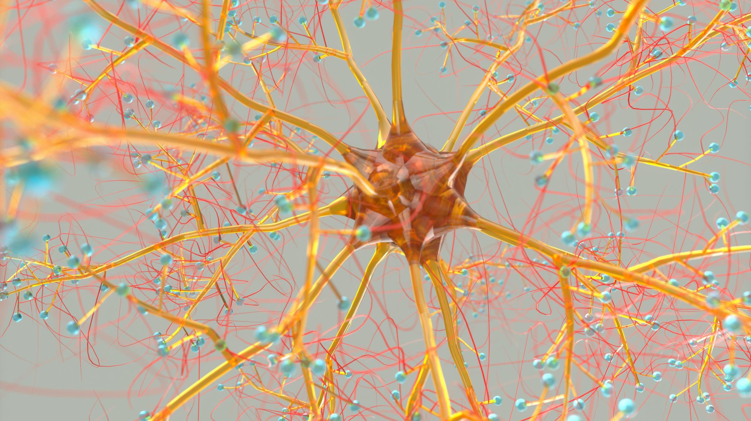
NEURAL NETWORK
TUTOR:
SUMAN DAHAL
Department of Software, NCIT
PRESENTED BY:
PRADIP DHUNGANA, 201751
BISHNU TIMILSENA, 201746
VIZION RIJAL, 201739
POOJA ACHARYA, 201750

Slide 2
Questions
Are you curious about how computers can understand and interpret human speech?
Have you ever wondered how self-driving cars navigate through complex traffic situations ?

Slide 3
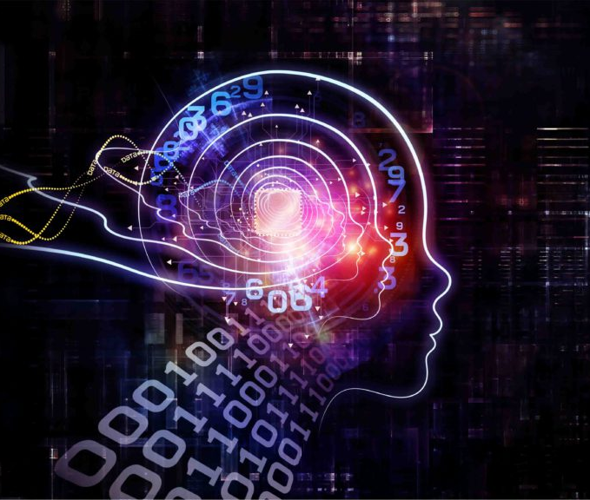
YUP. HERE IS THE ANSWER "NEURAL NETWORK"
Source : (Jucutan, 2018)

Slide 4
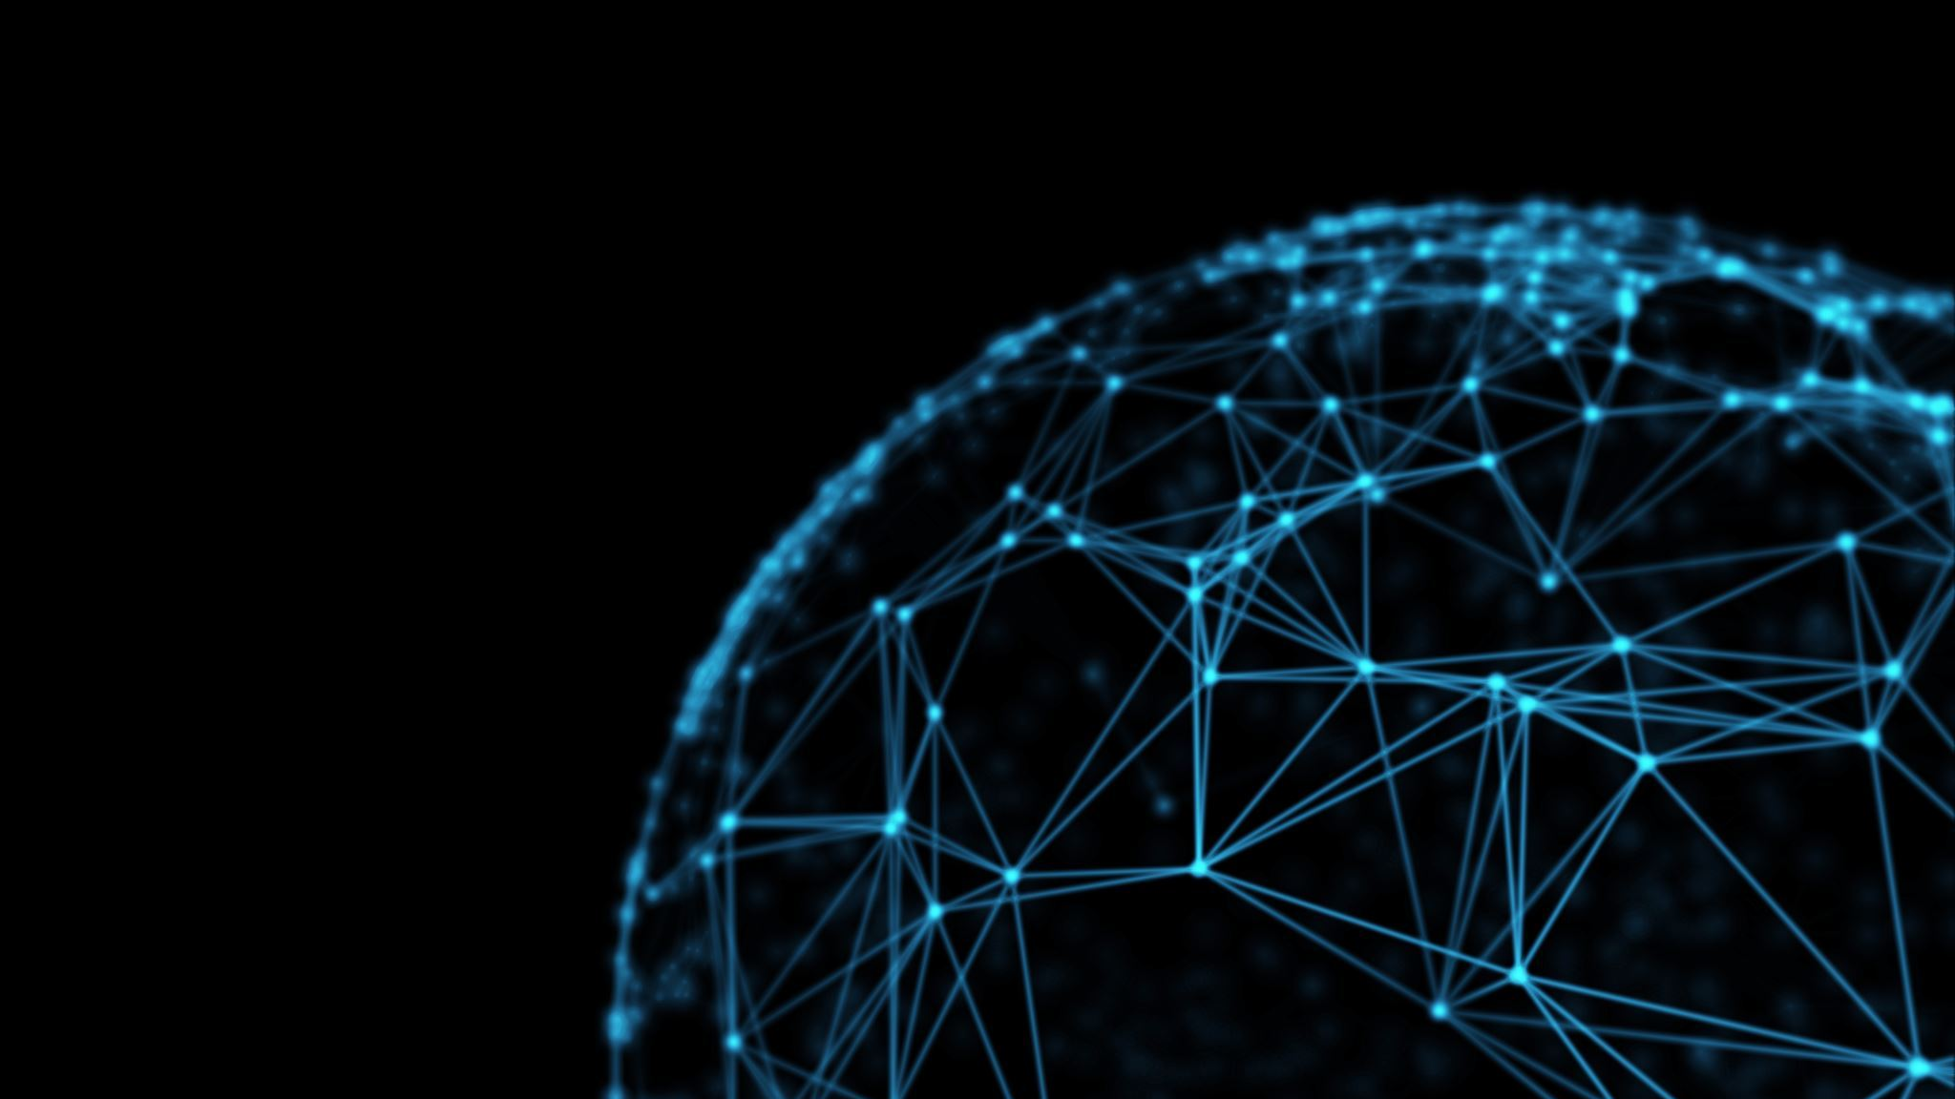
AGENDAS
INTRODUCTION
HISTORY AND BACKGROUND
WHY NEURAL NETWORKS ?
BASIC CONCEPTS OF ARTIFICIAL NEURONS
NEURAL NETWORK ARCHITECTURE
TRAINING AND NEURAL NETWORK ALGORITHMS
APPLICATION OF NEURAL NETWORKS
CHALLENGES AND FUTURE DIRECTIONS
CONCLUSION
REFERENCES

Slide 5
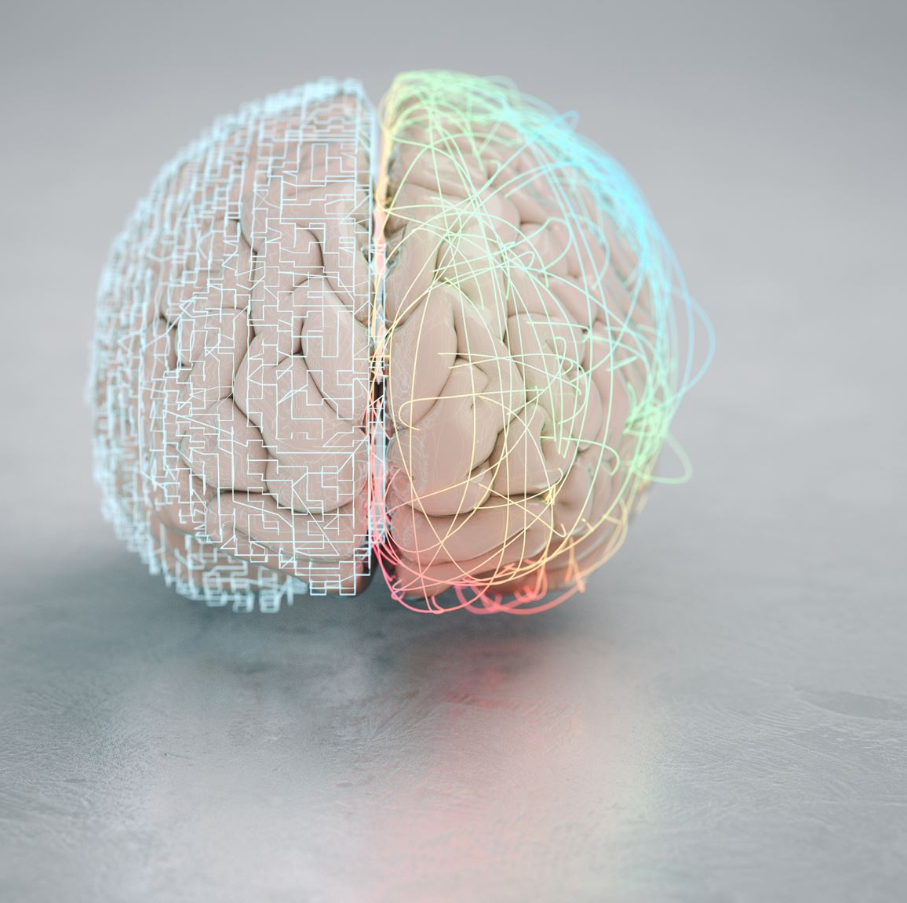
INTRODUCTION
According to (Gurney, K., 1997):
A neural network is a computer system inspired by the human brain that processes information through interconnected nodes.

Slide 6
HISTORY & BACKGROUND
According to ( Müller, B., Reinhardt, J. and Strickland, M.T., 1995)
Stage | Date | Development
McCulloch-Pitts Neuron | 1943 | Warren McCulloch and Walter Pitts proposed a simplified model of a biological neuron.
Perceptron | 1957 | Frank Rosenblatt developed the perceptron, an early neural network capable of learning and decision-making.
Backpropagation Algorithm | 1974 | Paul Werbos introduced the backpropagation algorithm for adjusting weights in a neural network.
Connectionism | 1980s | Researchers explored connectionism, which views cognitive processes as interconnected processing units.
Multilayer Perceptrons | - | Multilayer perceptrons (MLPs) enabled the construction of deeper neural networks, leading to deep learning.
Support Vector Machines | 2000s | Support vector machines (SVMs) gained popularity, overshadowing neural networks in machine learning.
Deep Learning Resurgence | 2010s | Advances in computation, data availability, and training algorithms revitalized interest in deep learning.
Breakthrough Applications | 2010s | Deep learning-based neural networks achieved significant success in areas like image recognition and NLP.
Transformer Model | 2017 | The transformer model revolutionized NLP tasks, employing self-attention mechanisms for contextual understanding.
Ongoing Advancements | - | Current research focuses on improving training techniques, addressing limitations, and exploring new architectures.

Slide 7
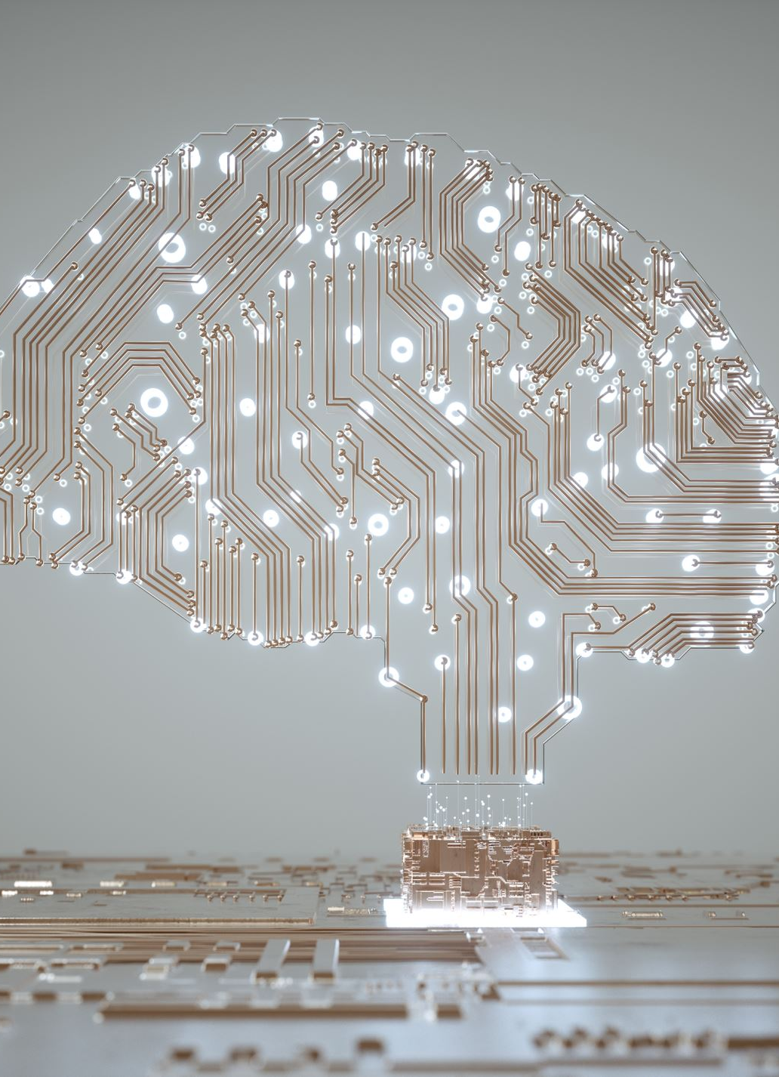
Why Neural Networks ?
Understanding the Brain:
Researchers driven to comprehend human brain principles.
Overcoming Computational Limitations:
Need for machines beyond sequential computers.
Focus on Complex Tasks:
Surge in neural networks to tackle complex tasks.
Advantages over Traditional Computers:
Neural networks excel where traditional computers fall short.

Slide 8
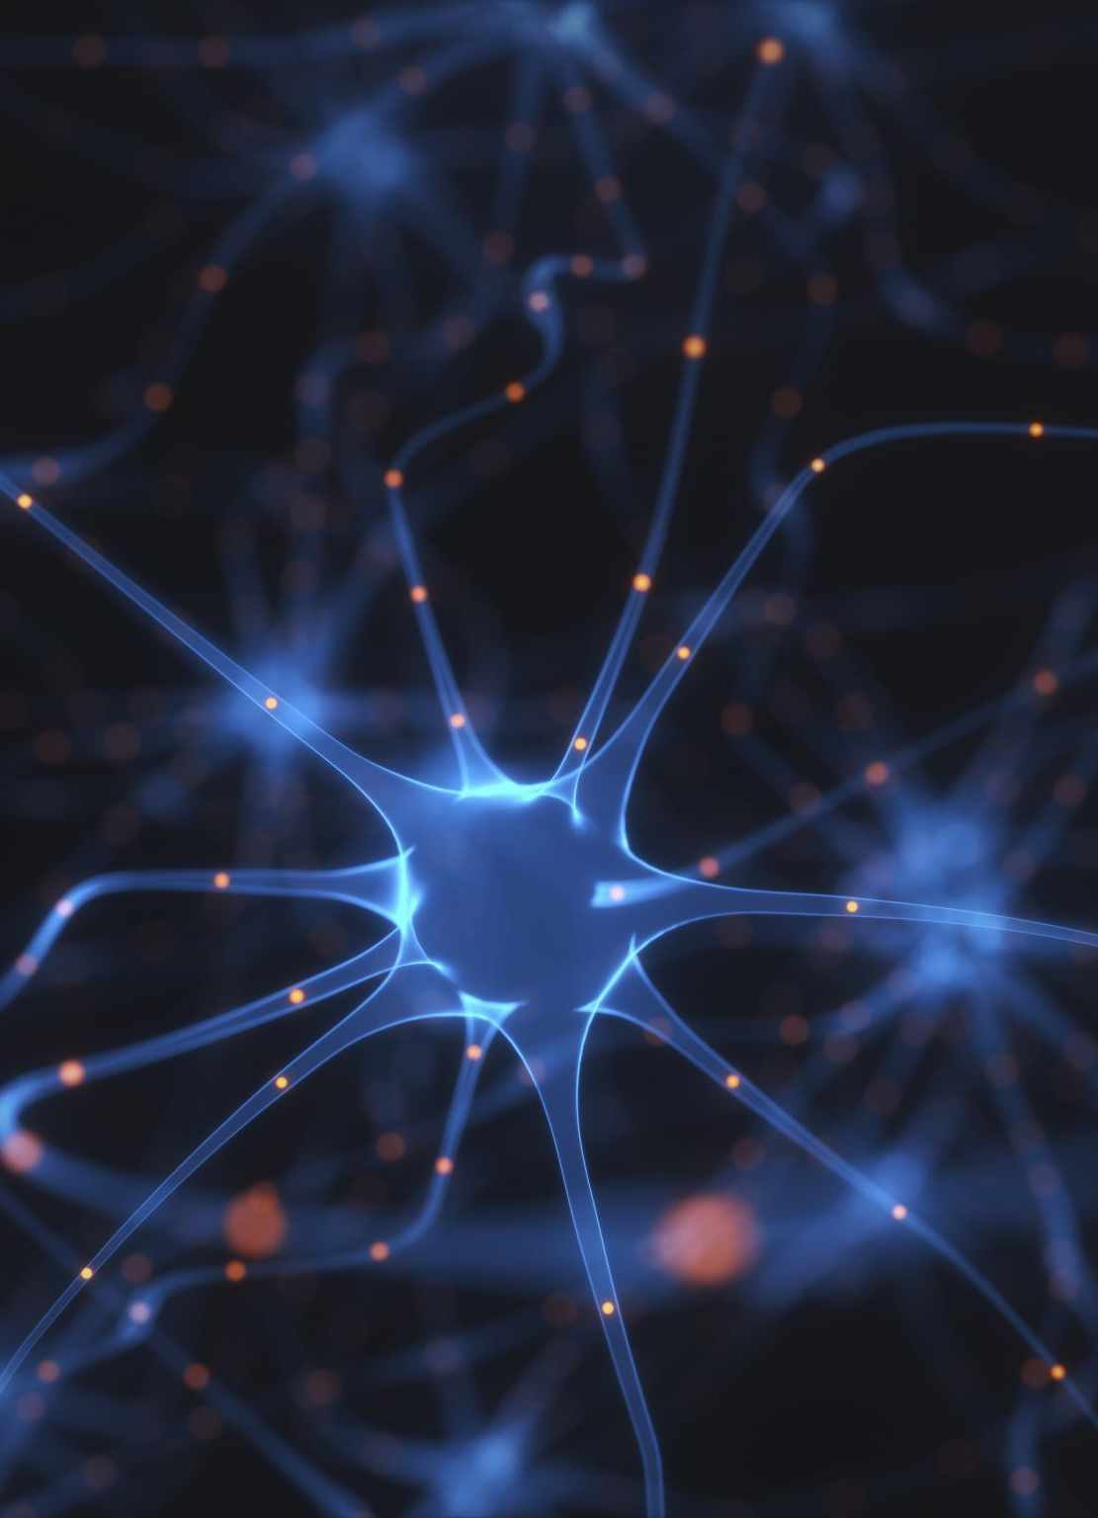
Basic concepts of artificial neurons and neural networks :
Artificial Neurons:
Artificial neurons, also known as nodes, are the fundamental processing elements of neural networks. They are computational models inspired by natural neurons.
Neural Signal Processing:
Artificial neurons receive input signals through synapses, similar to natural neurons receiving signals through dendrites or membranes.

Slide 9
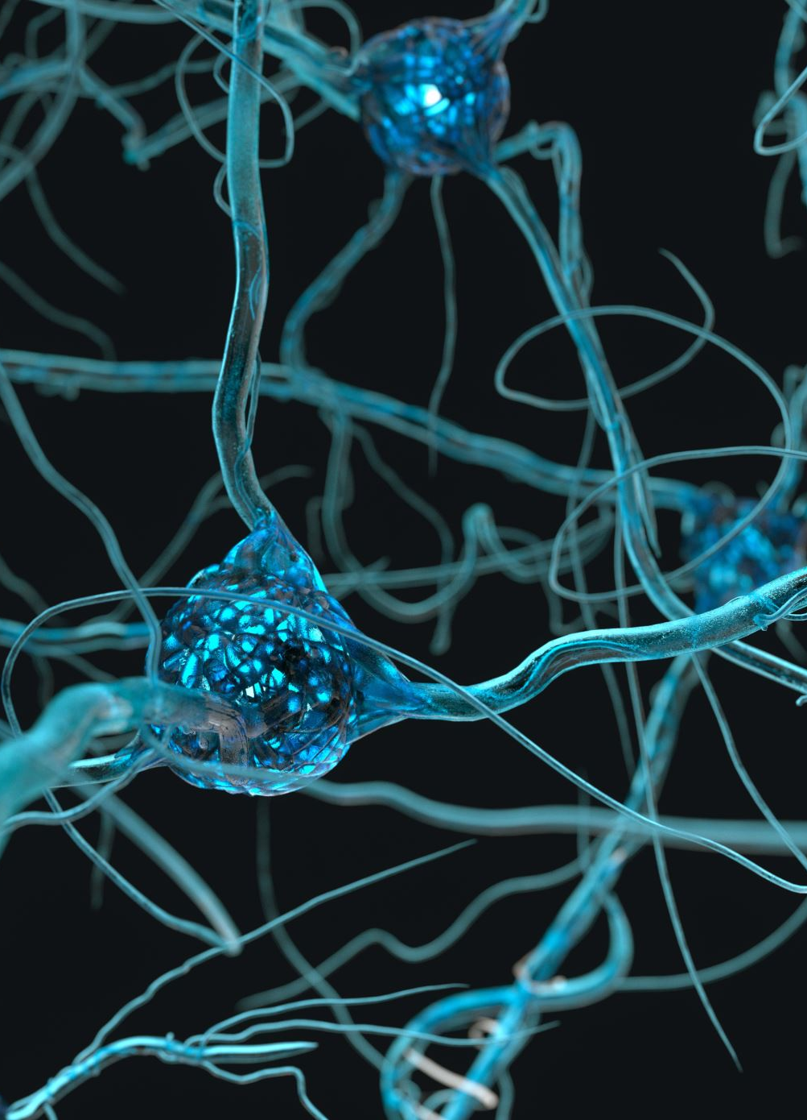
Basic concepts of artificial neurons and neural networks :
Activation Threshold:
If the input signals surpass a certain threshold, the artificial neuron is activated and emits an output signal through its axon.
Signal Transmission:
The output signal from one artificial neuron can be transmitted to other neurons through synapses, simulating the interconnected nature of natural neural networks.

Slide 10

Neural Network Architectures

Slide 11

Feedforward Neural Networks (Multilayer Perceptron)
a) Information processing technique
b) Meaningful answers with error-prone or incomplete data
c) Rapid processing for solving real-world problems

Slide 12
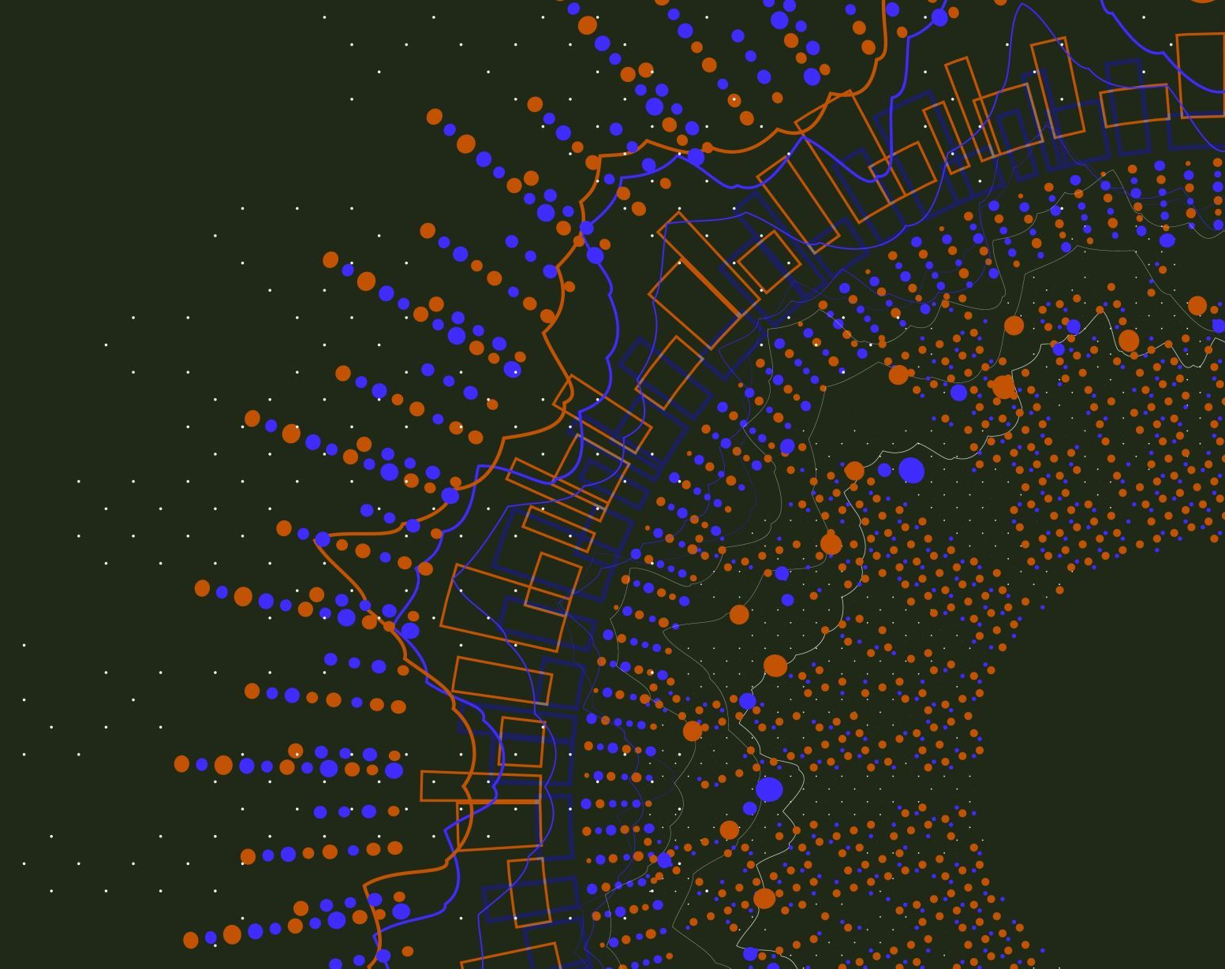
Recurrent Neural Networks (RNNs)
a) State of the art in time series prediction, system identification, and pattern classification.
b) Modification of multilayered feed-forward network with a context layer.
c) Context layer retains information between observations.

Slide 13
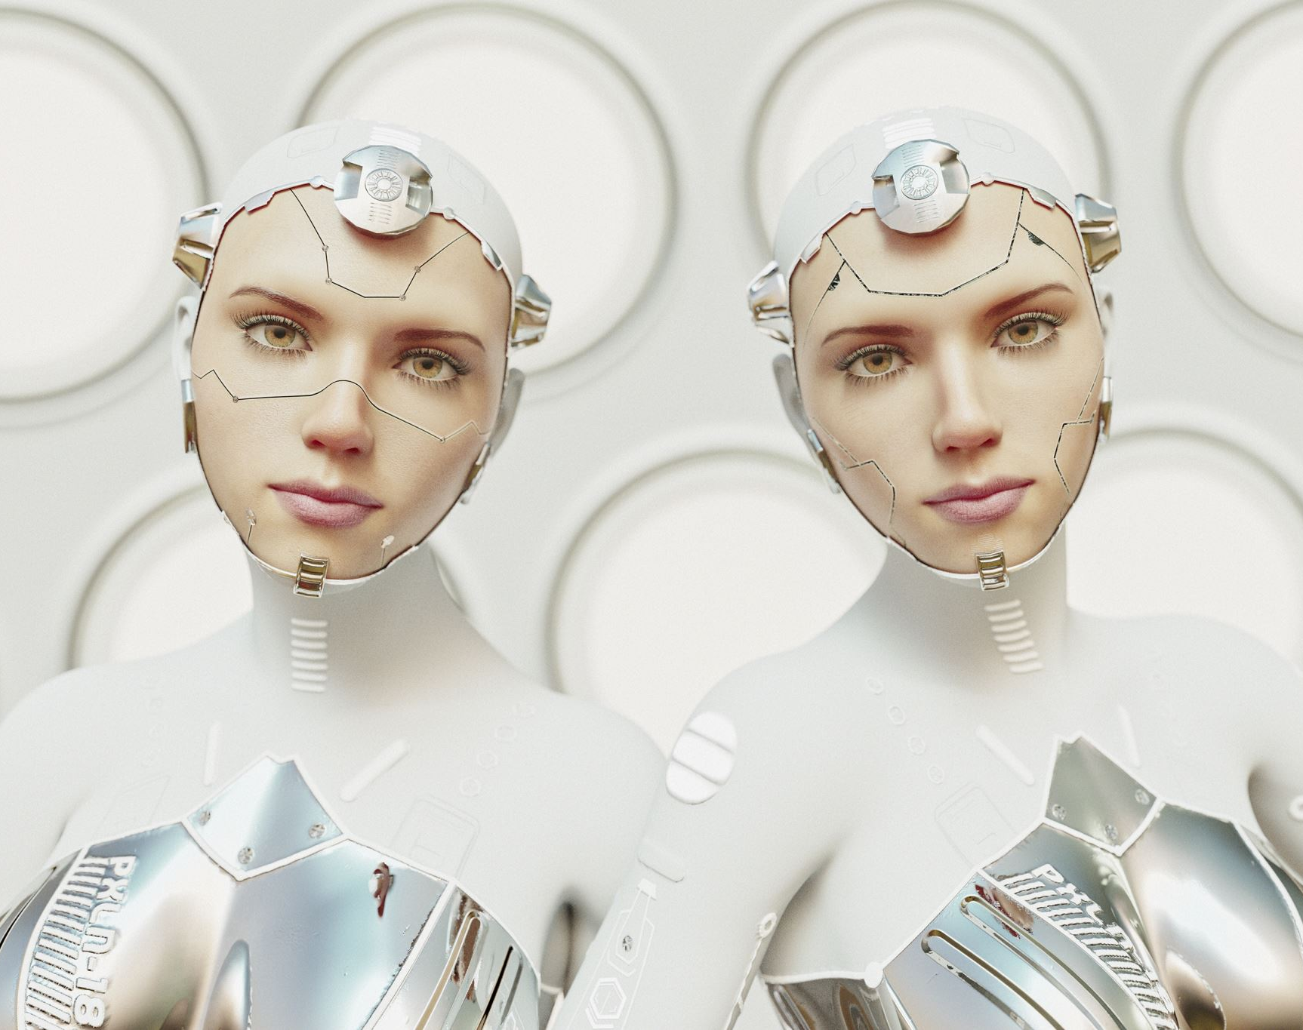
Convolutional Neural Networks (CNNs)
a) Used for facial recognition and image processing.
b) Training with a large database of pictures.
c) Sampling layers for evaluations and optimization of models for accurate recognition results.

Slide 14

Generative Adversarial Networks (GANS)
a) Learn deep representations without extensive annotated training data.
b) Competitive process involving a pair of networks.
c) Applications include image synthesis, semantic image editing, style transfer, image super resolution, and classification.

Slide 15

Radial Basis Function Networks (RBFNs)
a) Three-layer feed-forward network.
b) Linear transfer function for output units.
c) Nonlinear transfer function (often Gaussian) for hidden layer neurons.
(Chen, Cowan and Grant, 1991)

Slide 16
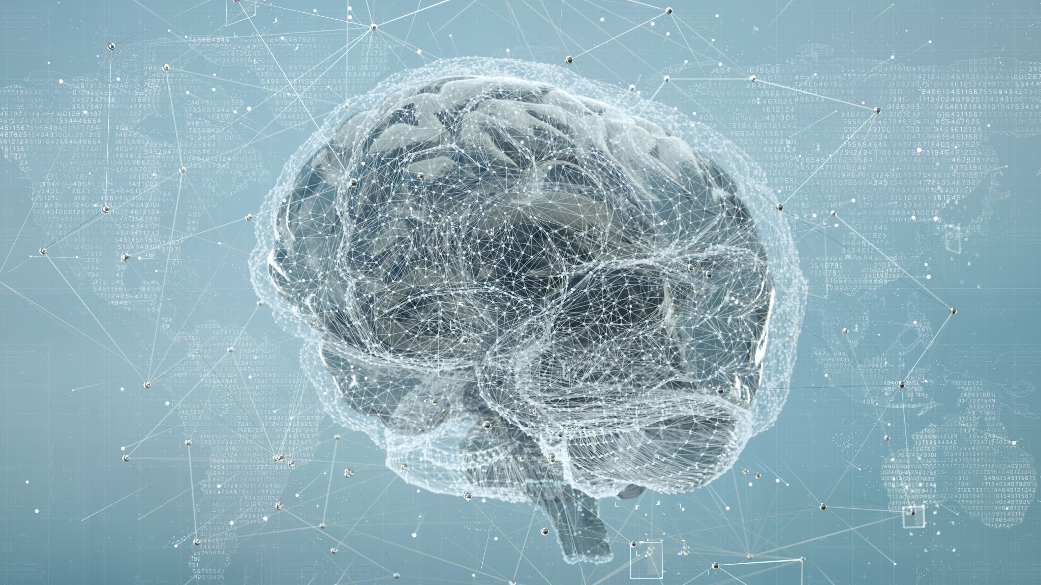
Training and Neural Networks Learning Algorithms

Slide 17
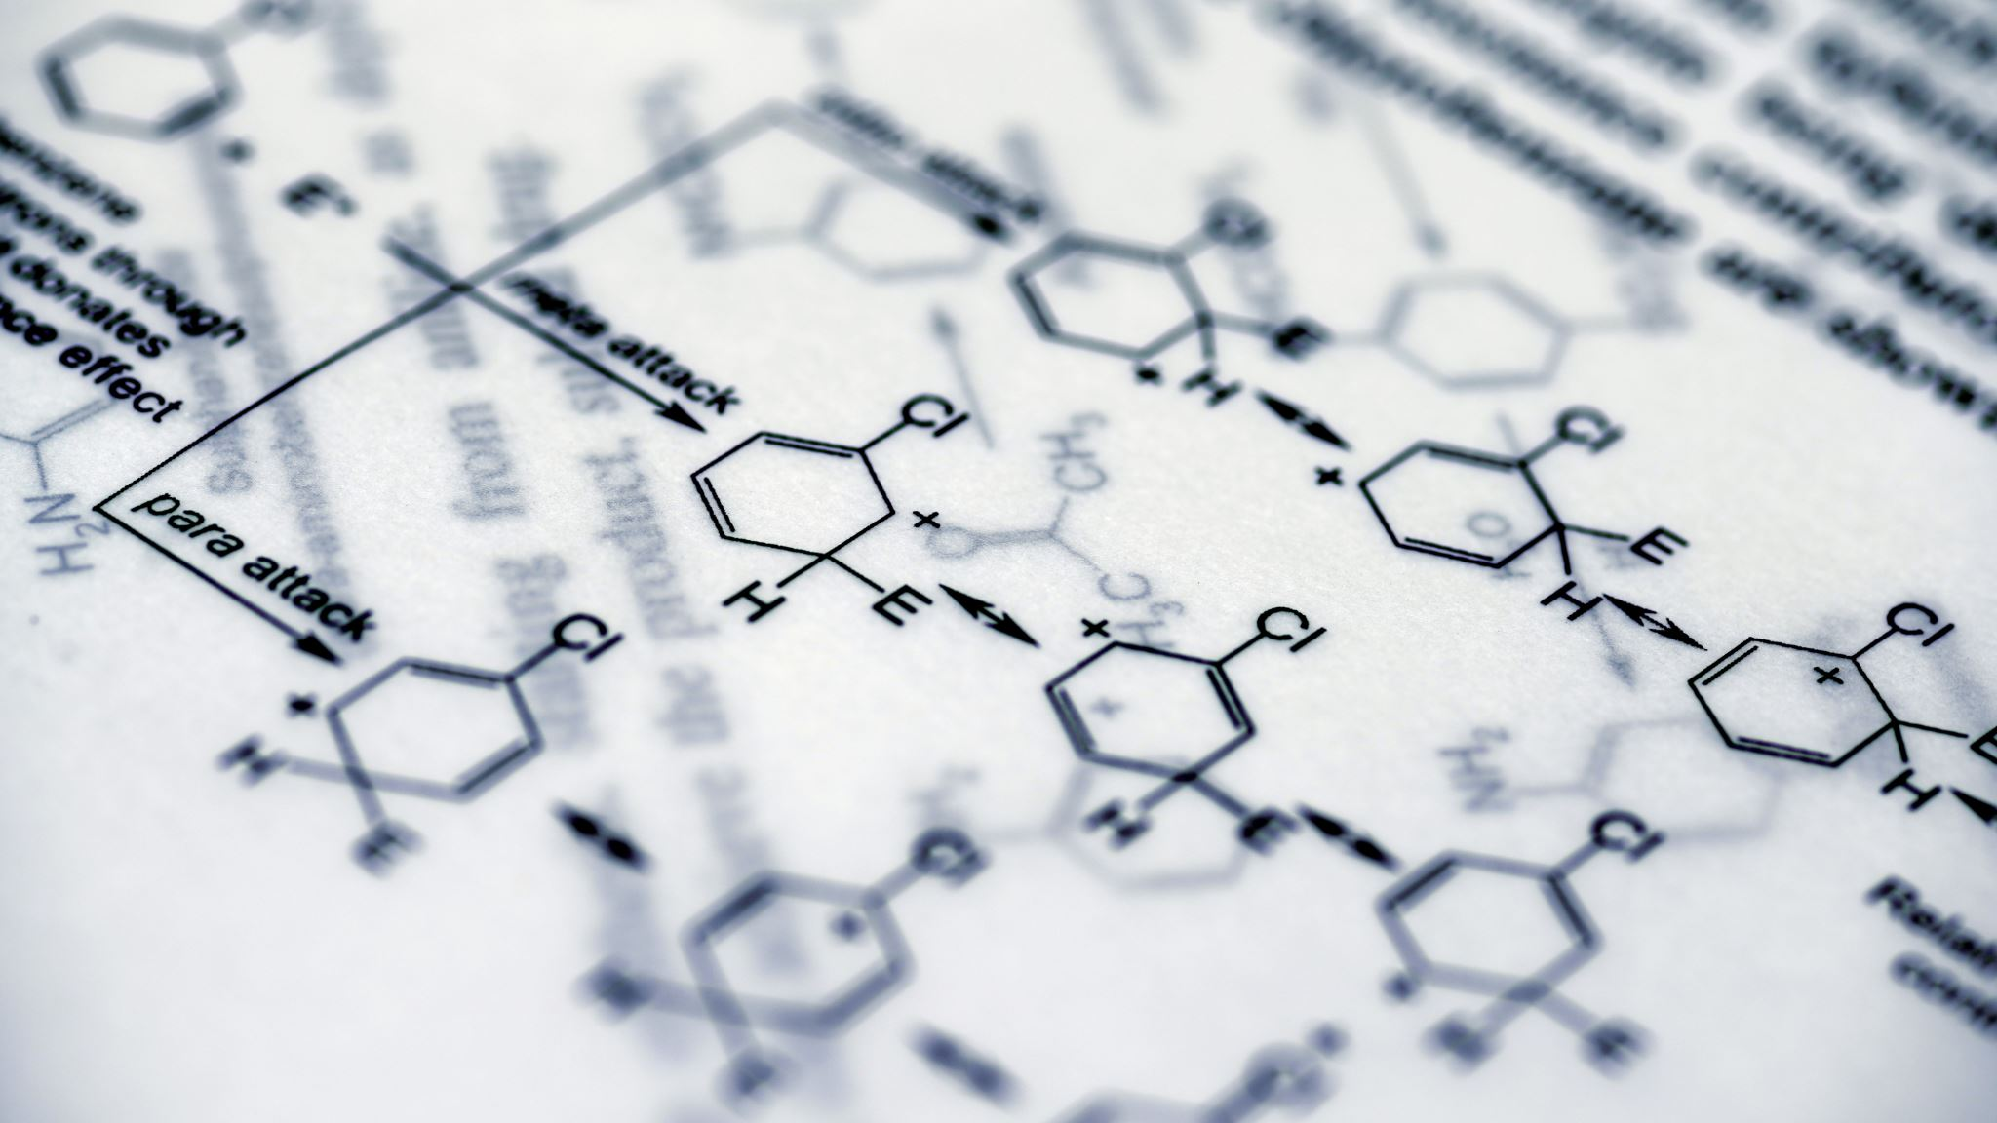
TRAINING :
a) Choosing the number of neurons
b) Regularization methods (dropout, weight decay)
c) Learning rate and convergence considerations

Slide 18
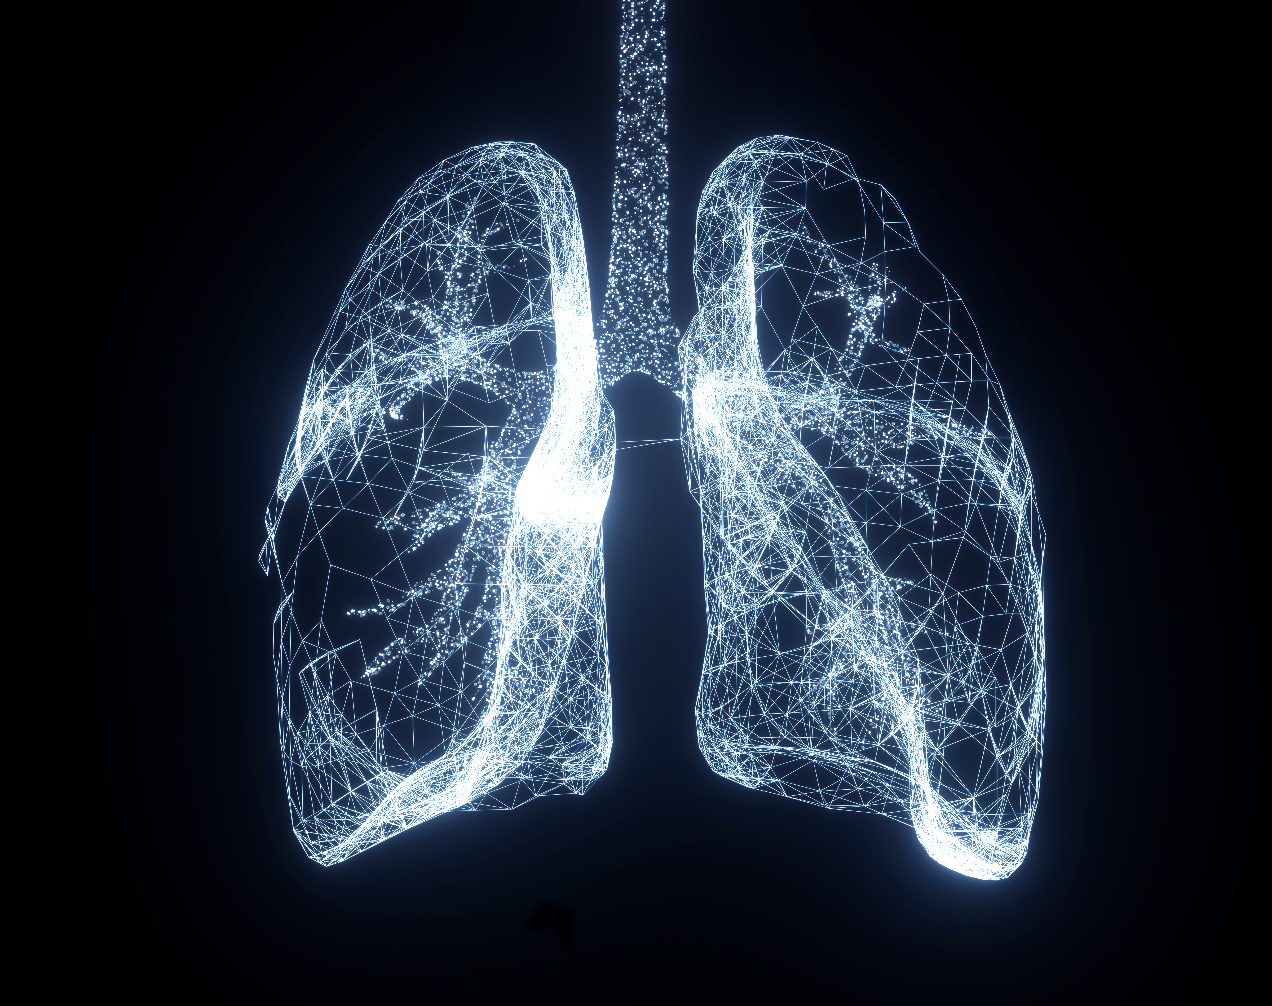
LEARNING ALGORITHMS

Slide 19
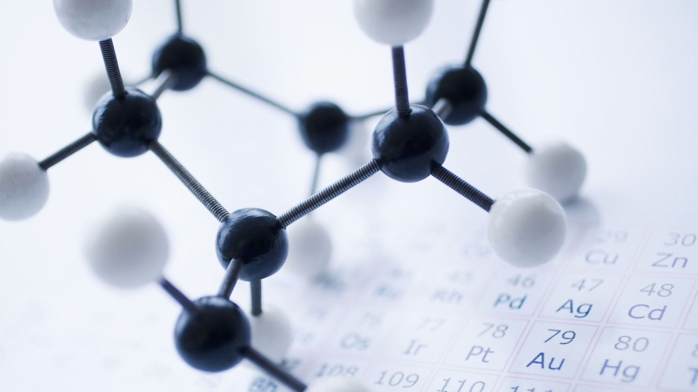
Backpropagation Learning
Crucial learning algorithm in neural networks.
Computes partial derivatives of the error with respect to each weight.
Modifies network weights based on these derivatives.
Error decreases towards a local minimum by weighting the negative derivatives.

Slide 20

Hebbian Learning
Key idea in connectionism.
Modifies synaptic connections based on activation patterns.
Connection strength increases with repeated stimulation.
Based on Hebb's 1949 theory of Hebbian Learning.

Slide 21

Perceptron Learning
Single layer neural network for pattern classification.
Trained to produce correct target vector for given input vector.
Utilizes perceptron learning rule for training.
Well-suited for simple problems in pattern classification.

Slide 22
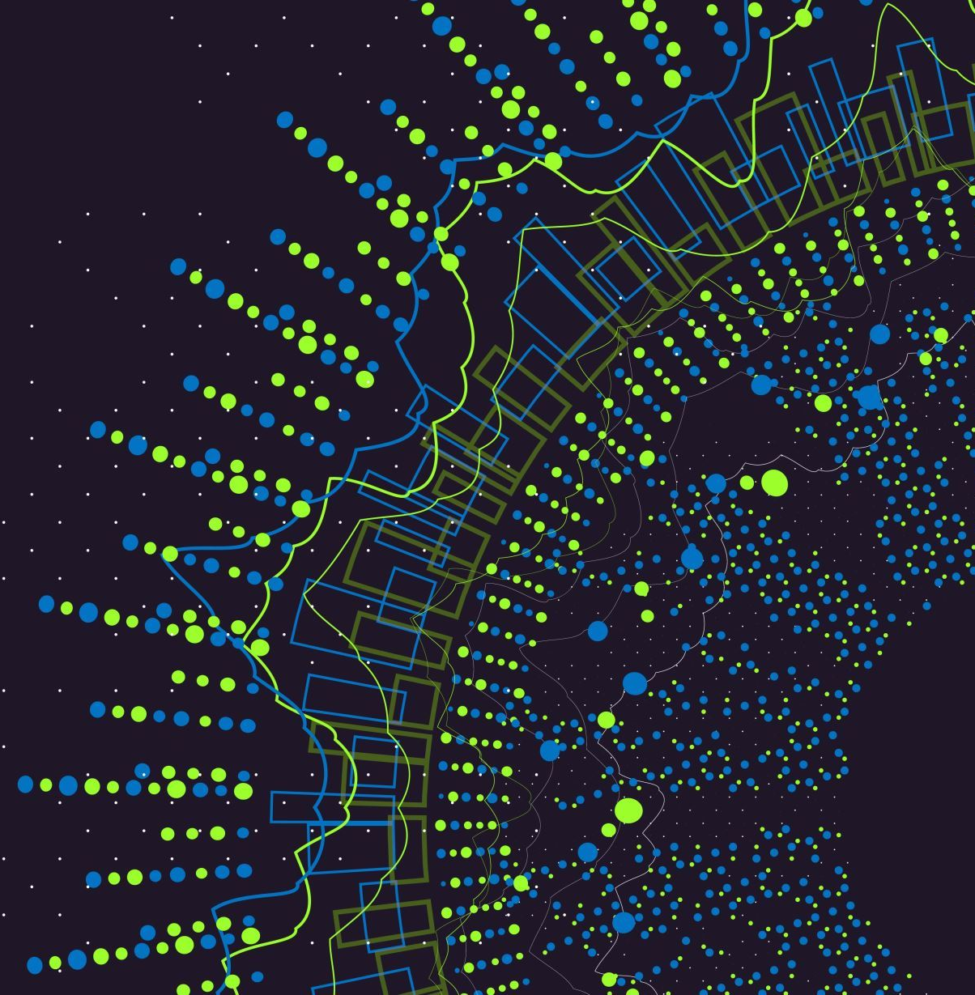
Applications of Neural Network
Recommendation Systems :
Provide content recommendations to users.
Enable automatic personalization to a large user base.
Facial Recognition:
Robust facial recognition in surveillance, authentication, and selective entries.
Convolutional Neural Networks (CNN) process large datasets for accurate recognition results.

Slide 23
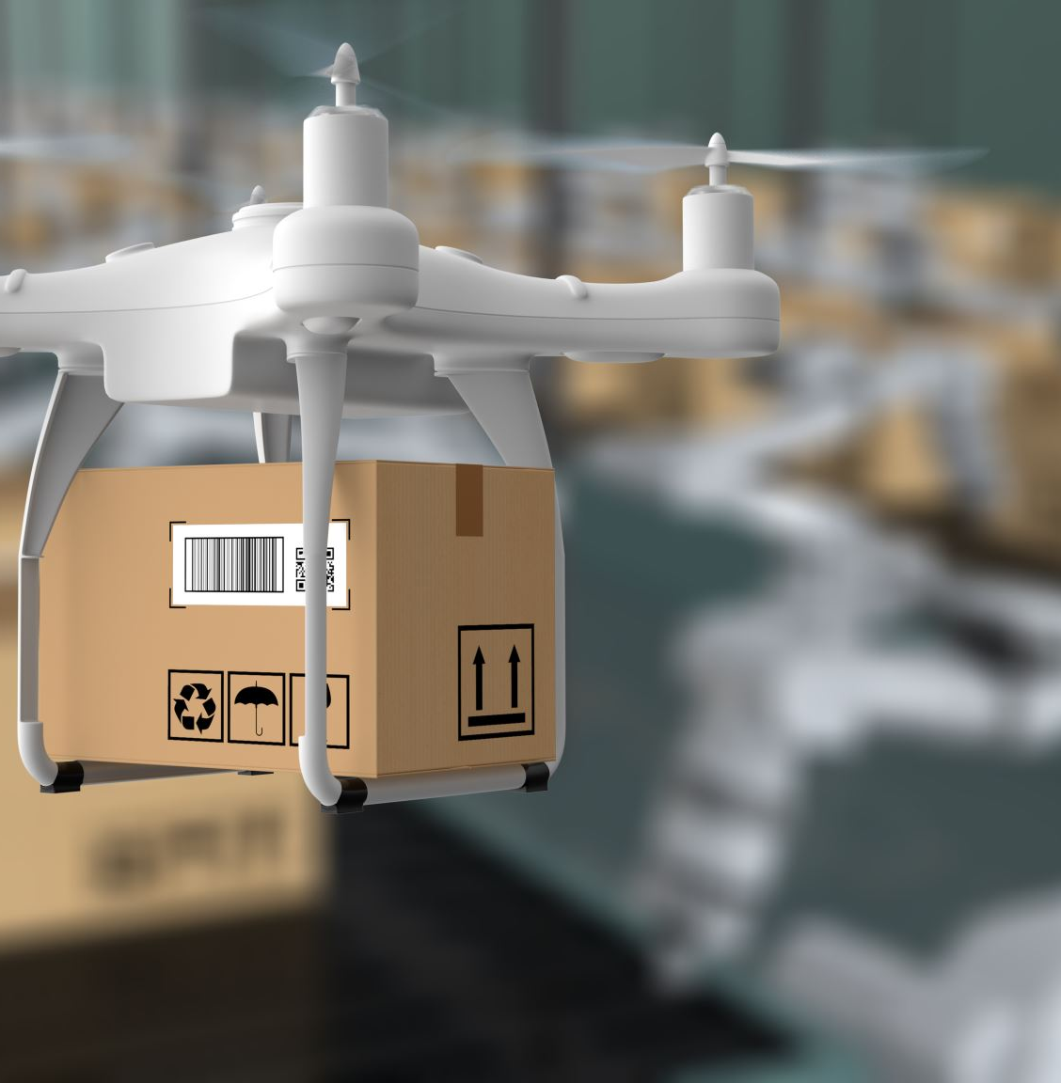
Applications of Neural Network
Aerospace Applications:
Time Delay Neural Networks (TNN), applied in aerospace engineering.
Used for fault diagnosis, auto piloting, control system security, and dynamic simulations.
Defense Systems:
Used for logistics, armed attack analysis, object location, air patrols, maritime patrols, and controlling automated drones.
Convolutional Neural Networks (CNN) utilized for underwater mine detection and image processing.

Slide 24
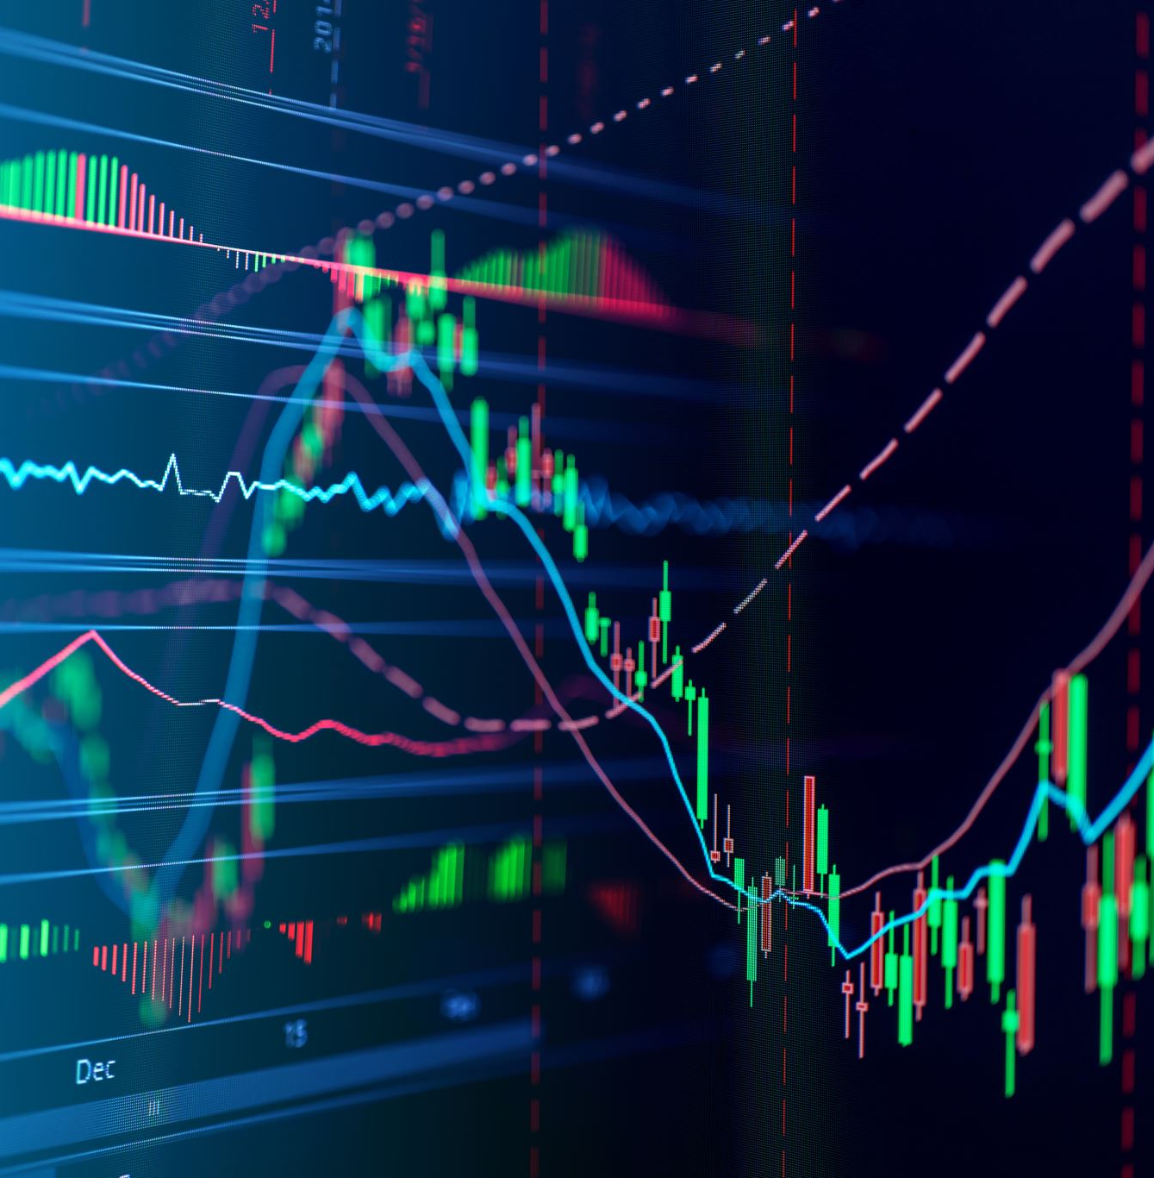
Applications of Neural Network
Stock Market Prediction:
Neural networks, particularly Multilayer Perceptron (MLP), used for real-time stock market predictions.
MLP models analyze past performances, annual returns, and ratios for accurate predictions.
Social Media Analysis:
Analyze social media user behaviors for competitive analysis and data mining.
MLP models forecast social media trends using factors like user preferences and bookmarked choices.

Slide 25

CHALLENGES AND FUTURE DIRECTIONS

Slide 26
Challenges :
Overfitting and underfitting
`Underfitting : Model fails to capture underlying data trend due to insufficient training data.
Overfitting: Model doesn't generalize well to unseen data, capturing noise instead of the underlying trend.
Data availability and quality
Data challenge: Neural networks need large amounts of data for accurate learning.
Data availability constraint: Insufficient data for some tasks or domains.
Interpretability and explainability
Interpretability challenge: Lack of understanding of how neural networks process data and make decisions.
Black box nature: Difficulty in comprehending learned features and decision-making process.

Slide 27
Advances in neural network research
Attention Mechanisms:
Enable models to focus on relevant parts of input data for efficiency.
Transformer Models:
Perform well in text production and language translation with parallel processing and capturing long-range dependencies.
Graph Neural Networks (GNNs):
Effective for processing data with complex relational structures, such as social networks and molecular graphs, capturing complex connections between nodes.

Slide 28
Potential future applications and impact of neural networks
Integration:
Can be integrated with complementary technologies, such as symbolic functions, to address their weaknesses and achieve better results.
Scaling up complexity:
Technological advancements enable larger and more efficient neural networks with increased processing power and data capacity.
New applications:
Neural networks have the potential to transform industries, improving efficiency, targeting new audiences, and enhancing product development and consumer safety.
Potential obsolescence:
Despite progress, neural networks may face limitations and alternative approaches may emerge as technology evolves to address complex problems.

Slide 29
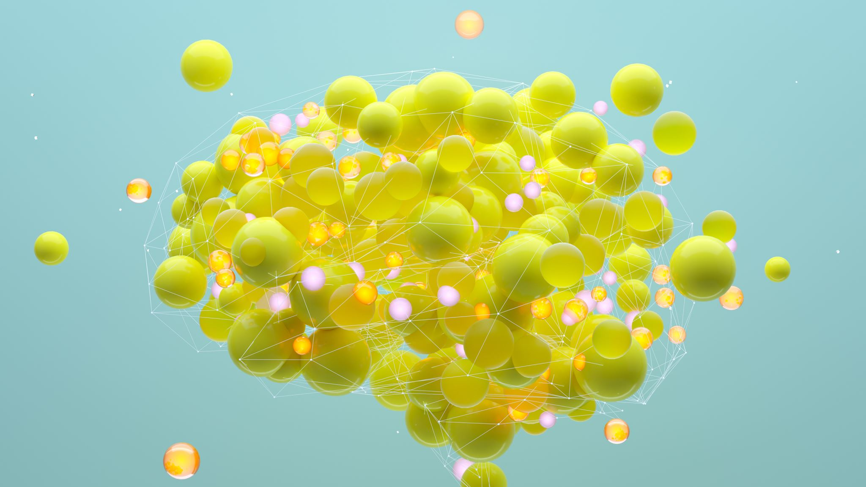
CONCLUSION
Neural networks mimic the human brain and process information through interconnected nodes.
Different network architectures include feedforward, recurrent, convolutional, generative adversarial, and radial basis function networks.
Training algorithms like backpropagation, Hebbian learning, and perceptron learning improve network performance.
Neural networks have diverse applications such as recommendation systems, facial recognition, stock market prediction, social media analysis, aerospace, and defense.
Challenges include overfitting, data availability, interpretability, and advancements like attention mechanisms and graph neural networks.

Slide 30
References:
Gurney, K., 1997. An introduction to neural networks. CRC press.
Jucutan, K. (2018). Artificial Neural Network: The Brain Behind Today’s Smart Technology - Coding Dojo Blog. [online] Coding Dojo Blog. Available at: https://www.codingdojo.com/blog/artificial-neural-network-brain-behind-todays-smart-technology.
Macukow, B., 2016. Neural networks–state of art, brief history, basic models and architecture. In Computer Information Systems and Industrial Management: 15th IFIP TC8 International Conference, CISIM 2016, Vilnius, Lithuania, September 14-16, 2016, Proceedings 15 (pp. 3-14). Springer International Publishing.
Müller, B., Reinhardt, J. and Strickland, M.T., 1995. Neural networks: an introduction. Springer Science & Business Media.
Abraham, A., 2005. Artificial neural networks. Handbook of measuring system design.
Gershenson, C., 2003. Artificial neural networks for beginners. arXiv preprint cs/0308031.
Kaushik, V. (2021). 8 Applications of Neural Networks | Analytics Steps. [online] www.analyticssteps.com. Available at: https://www.analyticssteps.com/blogs/8-applications-neural-networks.
Benardos, P.G. and Vosniakos, G.C., 2007. Optimizing feedforward artificial neural network architecture. Engineering applications of artificial intelligence, 20(3), pp.365-382.
Creswell, A., White, T., Dumoulin, V., Arulkumaran, K., Sengupta, B. and Bharath, A.A., 2018. Generative adversarial networks: An overview. IEEE signal processing magazine, 35(1), pp.53-65.
Sze, V., Chen, Y.H., Yang, T.J. and Emer, J.S., 2017. Efficient processing of deep neural networks: A tutorial and survey. Proceedings of the IEEE, 105(12), pp.2295-2329.
GeeksforGeeks. (2023). Advantages and Disadvantages of Deep Learning. [online] Available at: https://www.geeksforgeeks.org/advantages-and-disadvantages-of-deep-learning/.
IBM Developer. (n.d.). Deep learning architectures. [online] Available at: https://developer.ibm.com/articles/cc-machine-learning-deep-learning-architectures/.
Wang, S., Nepal, S., Rudolph, C., Grobler, M., Chen, S. and Chen, T., 2020. Backdoor attacks against transfer learning with pre-trained deep learning models. IEEE Transactions on Services Computing, 15(3), pp.1526-1539.
Arulkumaran, K., Deisenroth, M.P., Brundage, M. and Bharath, A.A., 2017. Deep reinforcement learning: A brief survey. IEEE Signal Processing Magazine, 34(6), pp.26-38.
Lotfinejad, M. (2023). Deep Learning Applications.
Potential, challenges and future directions for deep learning in prognostics and health management applications’ 2020, Engineering Applications of Artificial Intelligence, vol. 92, p. 103678
www.linkedin.com. (n.d.). What are the current challenges and limitations of neural networks and deep learning? [online] Available at: https://www.linkedin.com/advice/3/what-current-challenges-limitations-neural#:~:text=One%20of%20the%20main%20challenges [Accessed 24 Jun. 2023].
ReadWrite. (2019). Everything You Need to Know About the Future of Neural Networks. [online] Available at: https://readwrite.com/everything-you-need-to-know-about-the-future-of-neural-networks/.

Slide 31

ANY QUERIES ?

Slide 32

THANK YOU

